Slide 1











Visualization with the ArcGIS API for JavaScript
Kristian Ekenes
2020 ESRI FEDERAL GIS CONFERENCE | WASHINGTON, D.C.

Slide 2




Discover how to visualize geodata in a meaningful way using the ArcGIS API for JavaScript
Notes:
Motivation – why are they here

Slide 3
One visualization cannot tell the whole story
Notes:
Motivation – why are they here

Slide 4
API Overview
Renderers, symbols, etc.

Slide 5
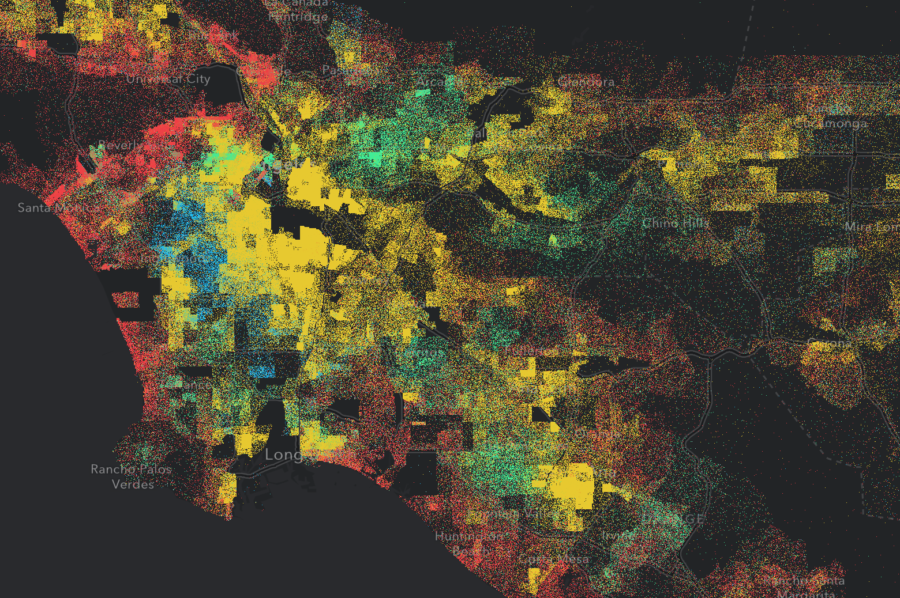
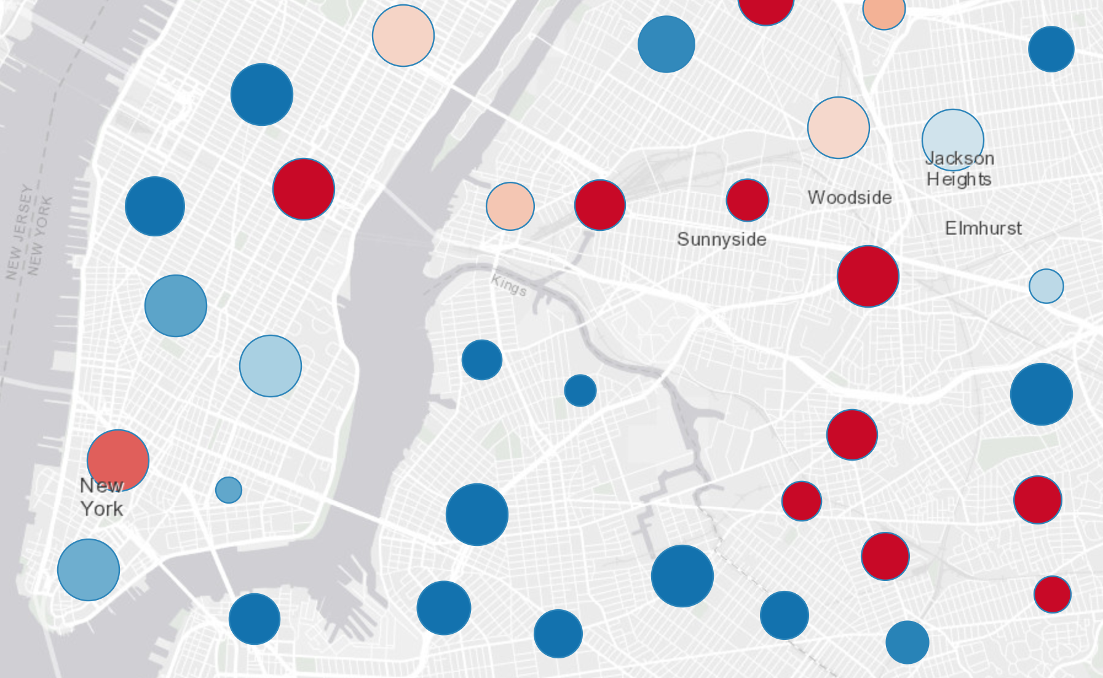
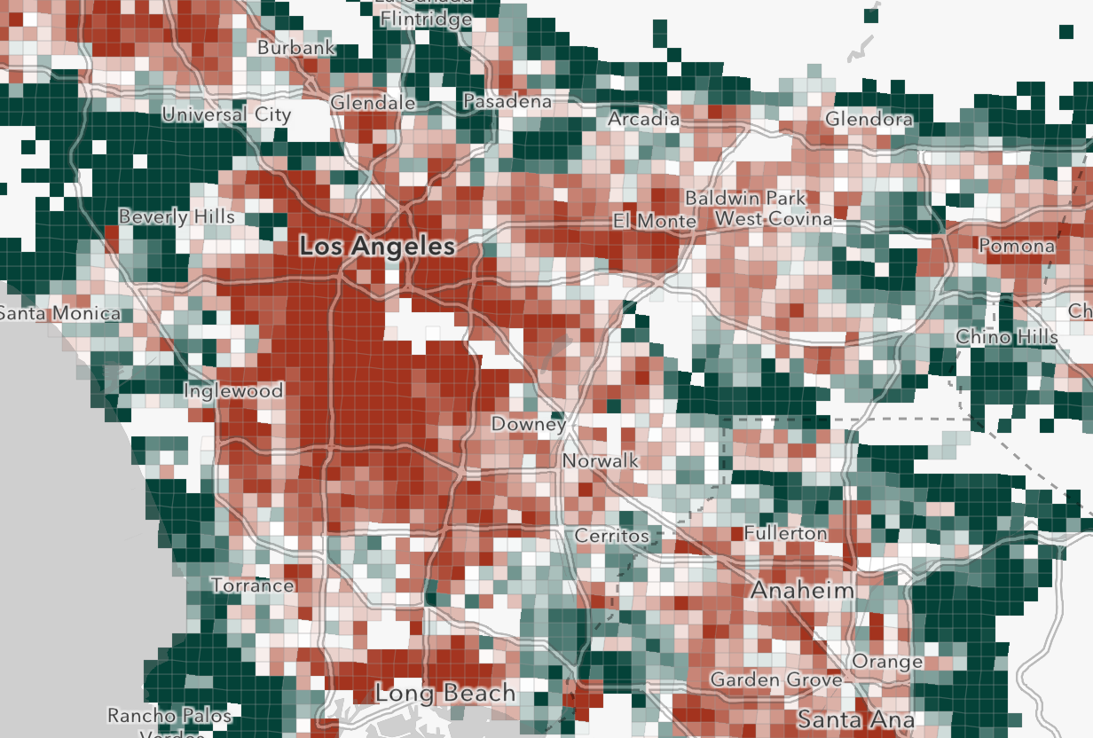
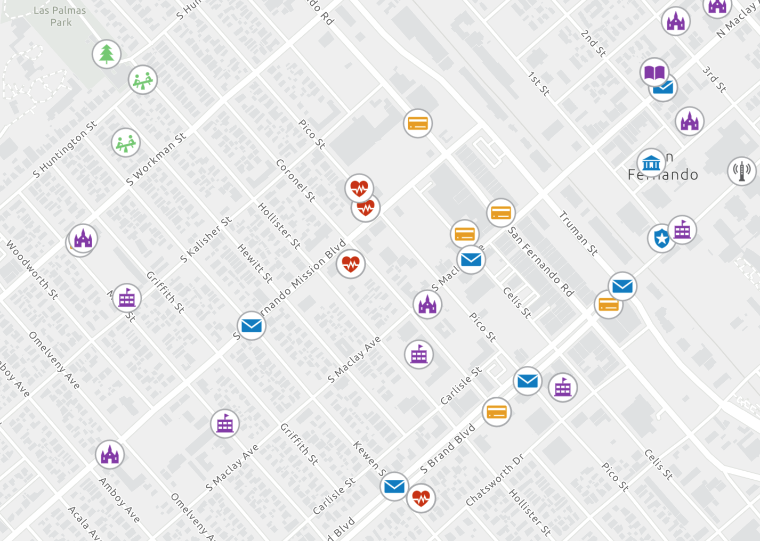
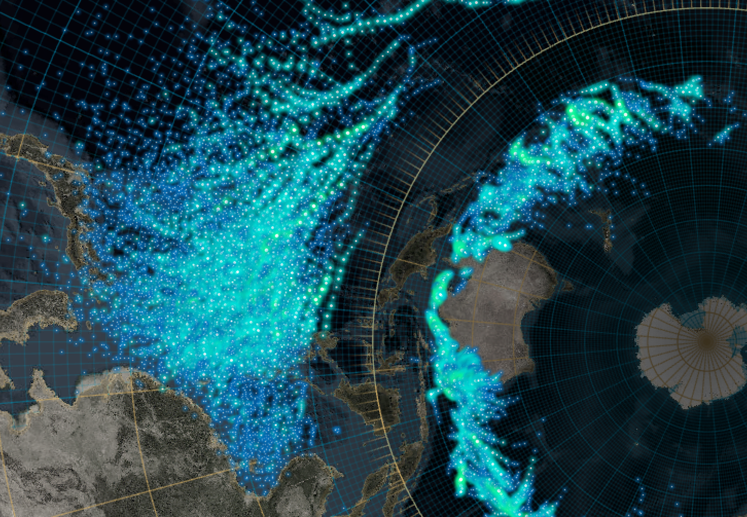






What can we visualize?
Where?
What?
How much?
When?
Multivariate

Slide 6
Symbols

Slide 7
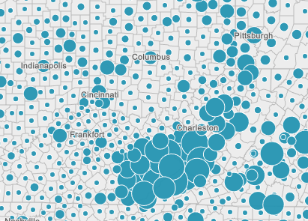
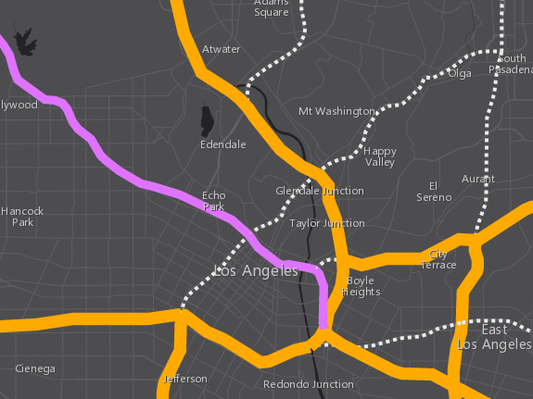
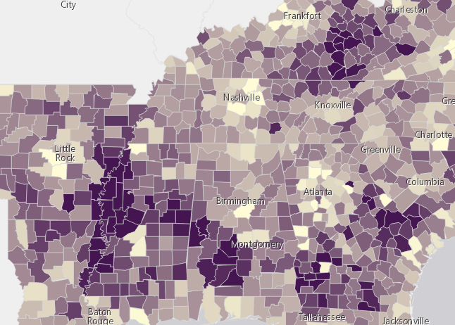


Symbols
based on geometry type
Points
Lines
Polygons
SimpleMarkerSymbol
SimpleLineSymbol
SimpleFillSymbol
PictureMarkerSymbol
PictureFillSymbol
WebStyleSymbol
CIMSymbol

Slide 8
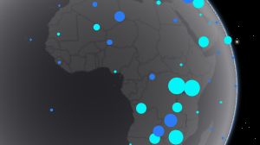
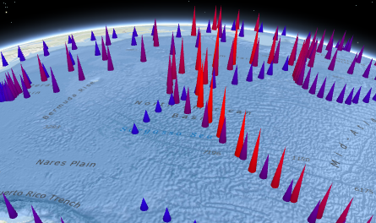
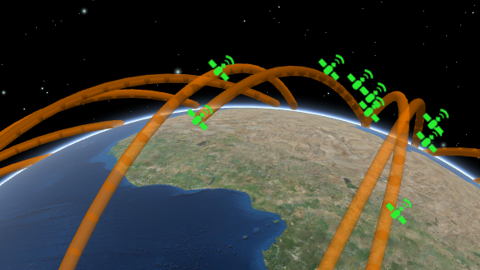
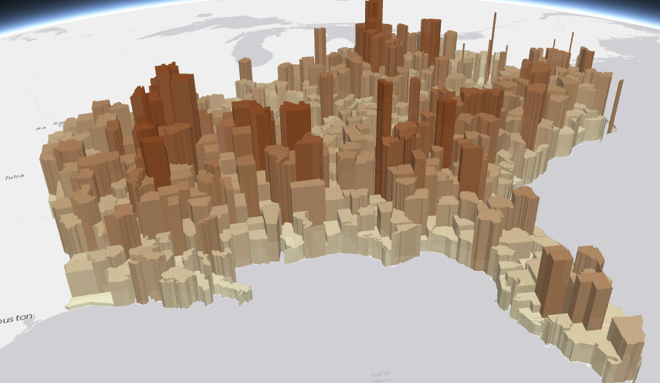
Symbols
PointSymbol3D
LineSymbol3D
PolygonSymbol3D
IconSymbol3DLayer
LineSymbol3DLayer
FillSymbol3DLayer
Flat
Screen size units (pt, px)
- Graphics are in screen space
PathSymbol3DLayer
ExtrudeSymbol3DLayer
Volumetric
- Real world units (feet, meter)
- Graphics are in real world space
ObjectSymbol3DLayer

Slide 9

Symbols
MeshSymbol3D
FillSymbol3DLayer

Slide 10
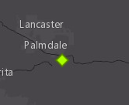
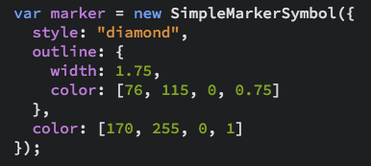
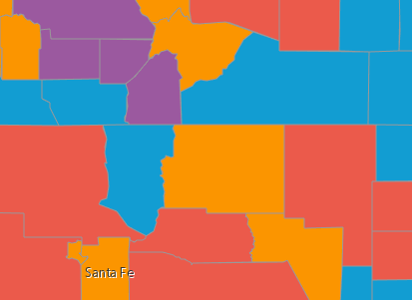
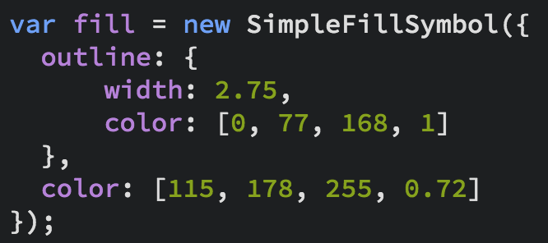
Symbols
Notes:
Show the playground here

Slide 11
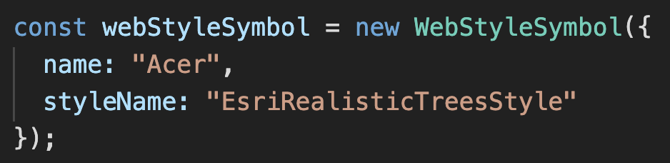
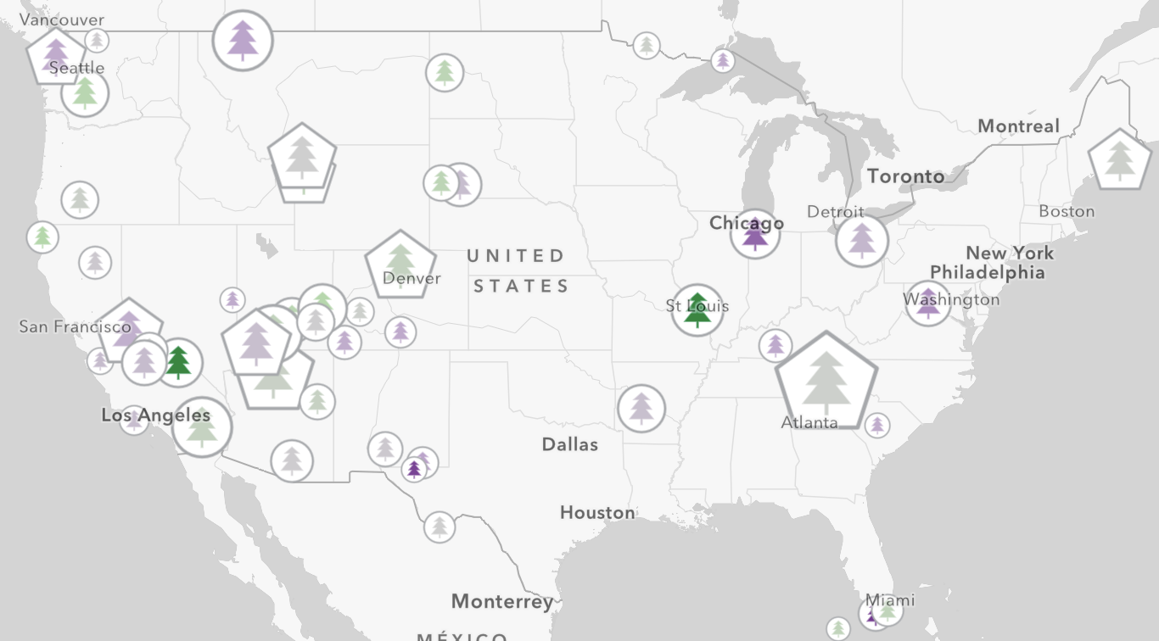
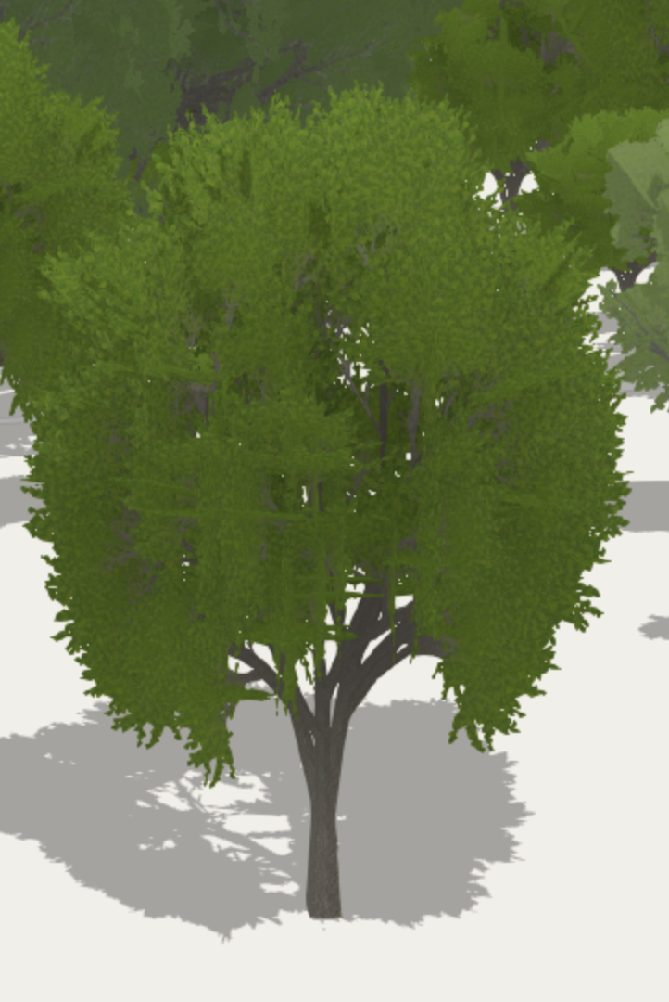
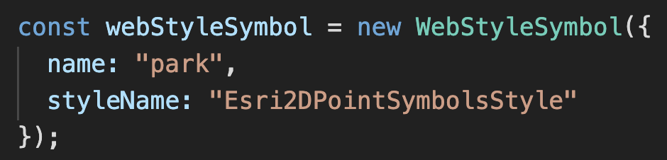
Web Style Symbols
3d styles
2d styles
Notes:
Show the playground here

Slide 12
Data
FeatureLayer
MapImageLayer
SceneLayer
StreamLayer
CSVLayer
GeoJSONLayer
FeatureCollection

Slide 13
Data-driven visualization
Field value(s)
TOTAL_POP
Arcade expression
Round( ( ($feature.BACHELOR + $feature.MASTER) / $feature.POP_25UP) * 100 );

Slide 14
Renderers

Slide 15
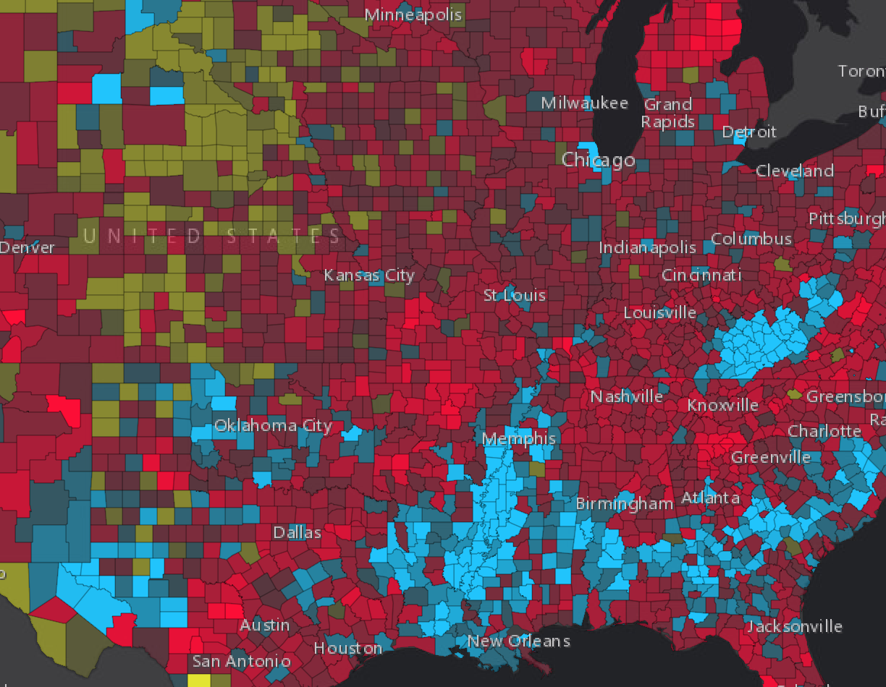
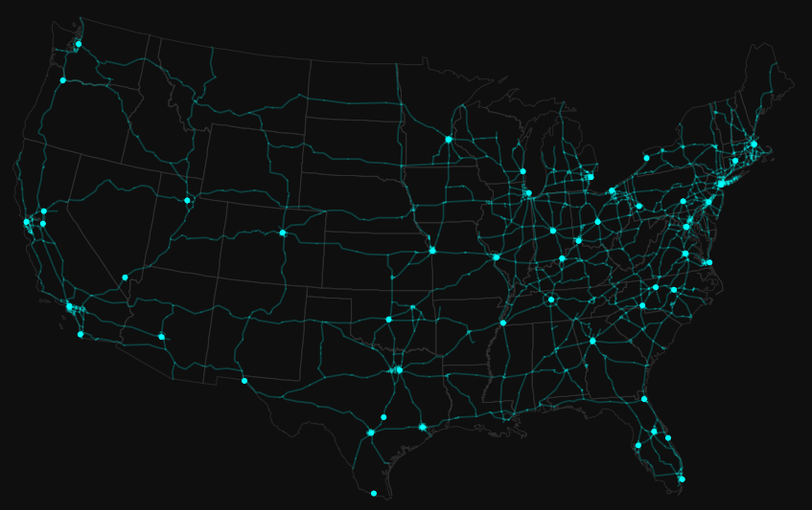
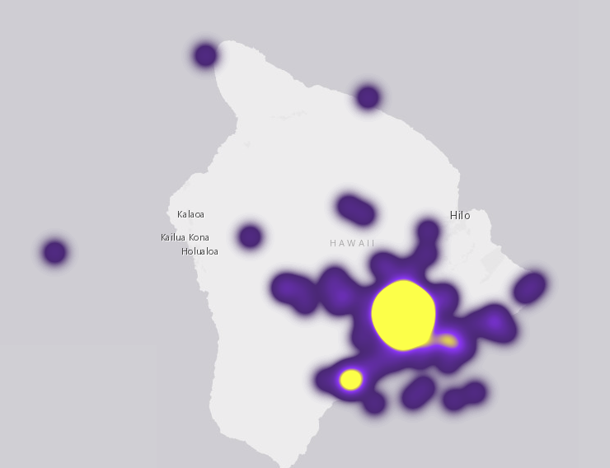
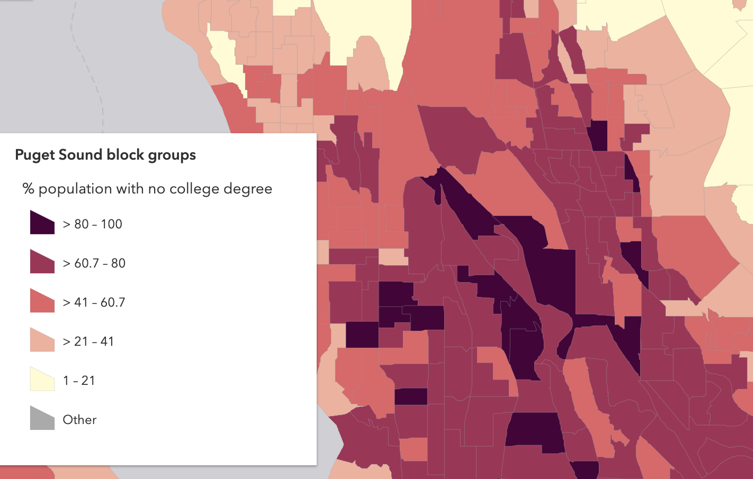
Renderers
UniqueValue
Simple
Heatmap
ClassBreaks

Slide 16
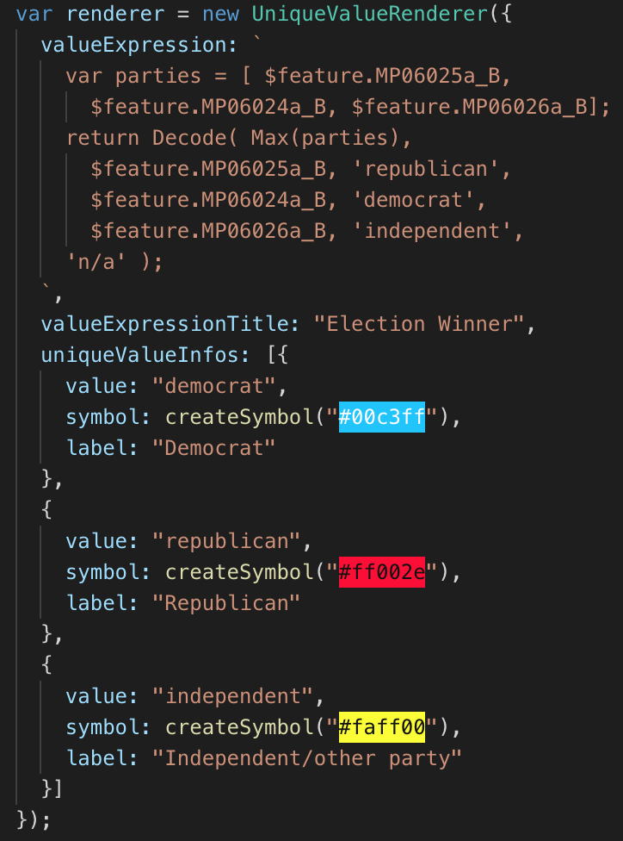
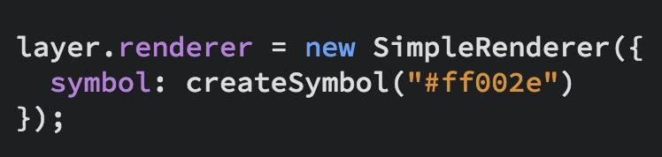
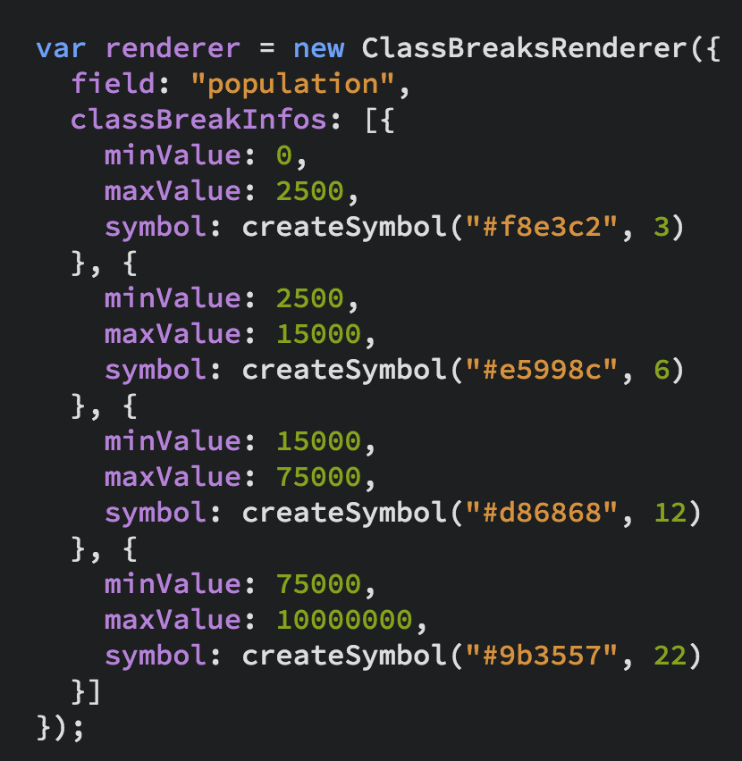
UniqueValueRenderer
Renderers
SimpleRenderer
ClassBreaksRenderer

Slide 17
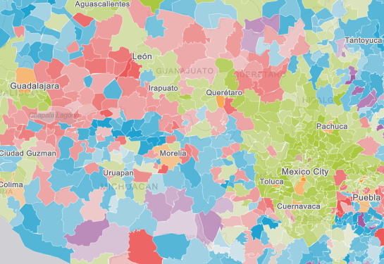
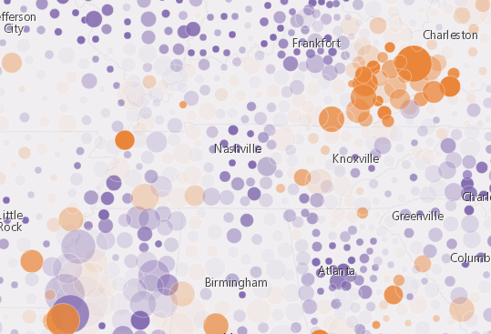
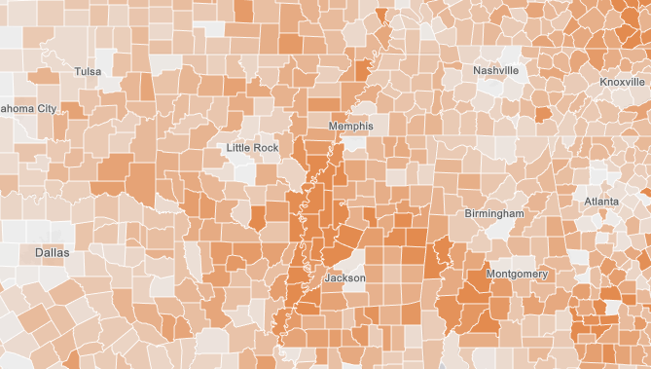
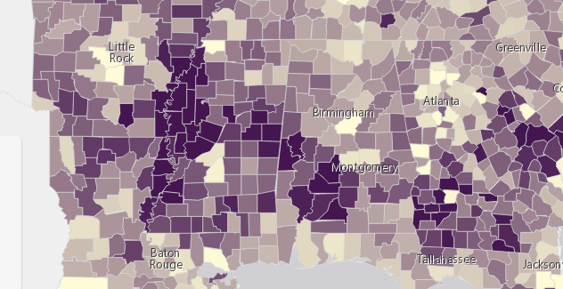
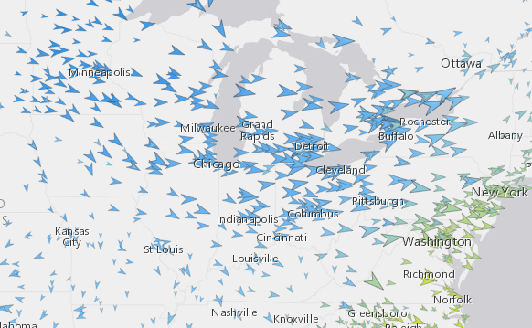
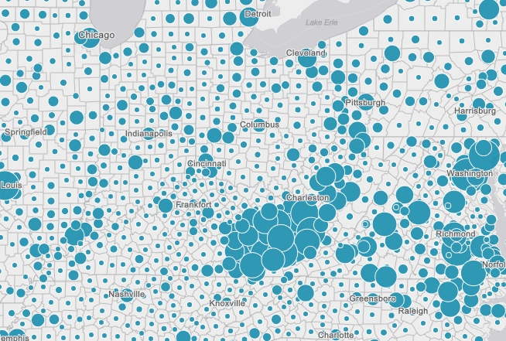
Renderers
Visual Variables
A property of the renderer
For numeric data-driven continuous visualizations
Color
Size
Opacity
Rotation

Slide 18
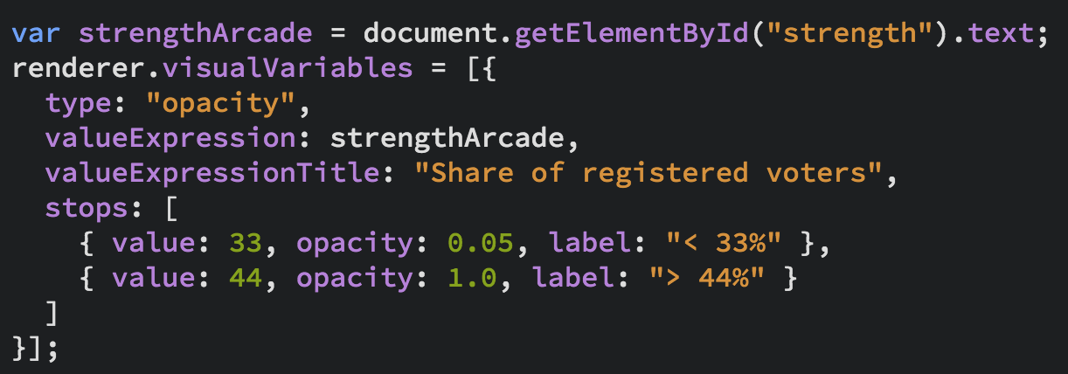
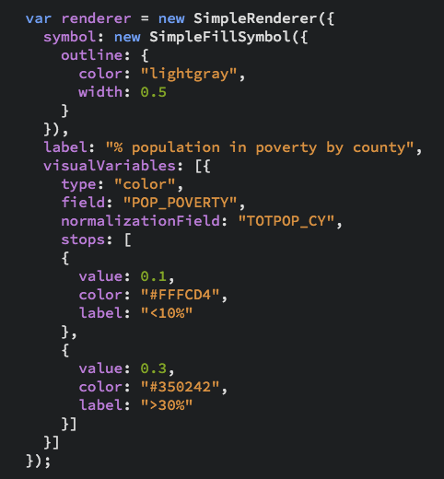
Renderers
Visual Variables

Slide 19
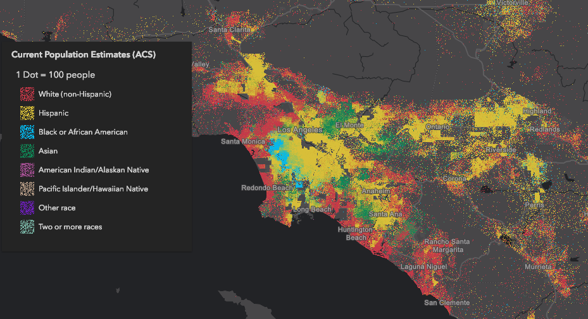
Dot Density

Slide 20
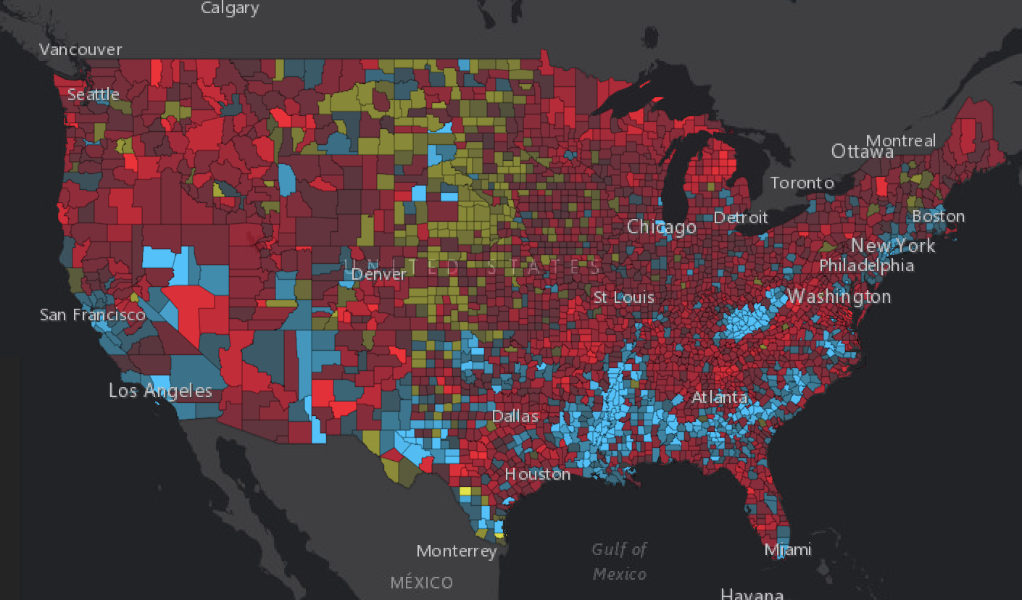

Examples
Political Party Affiliation

Slide 21
Symbol Size by Scale
ArcGIS blog: How and why to size symbols by scale in web maps

Slide 22
Smart Mapping

Slide 23
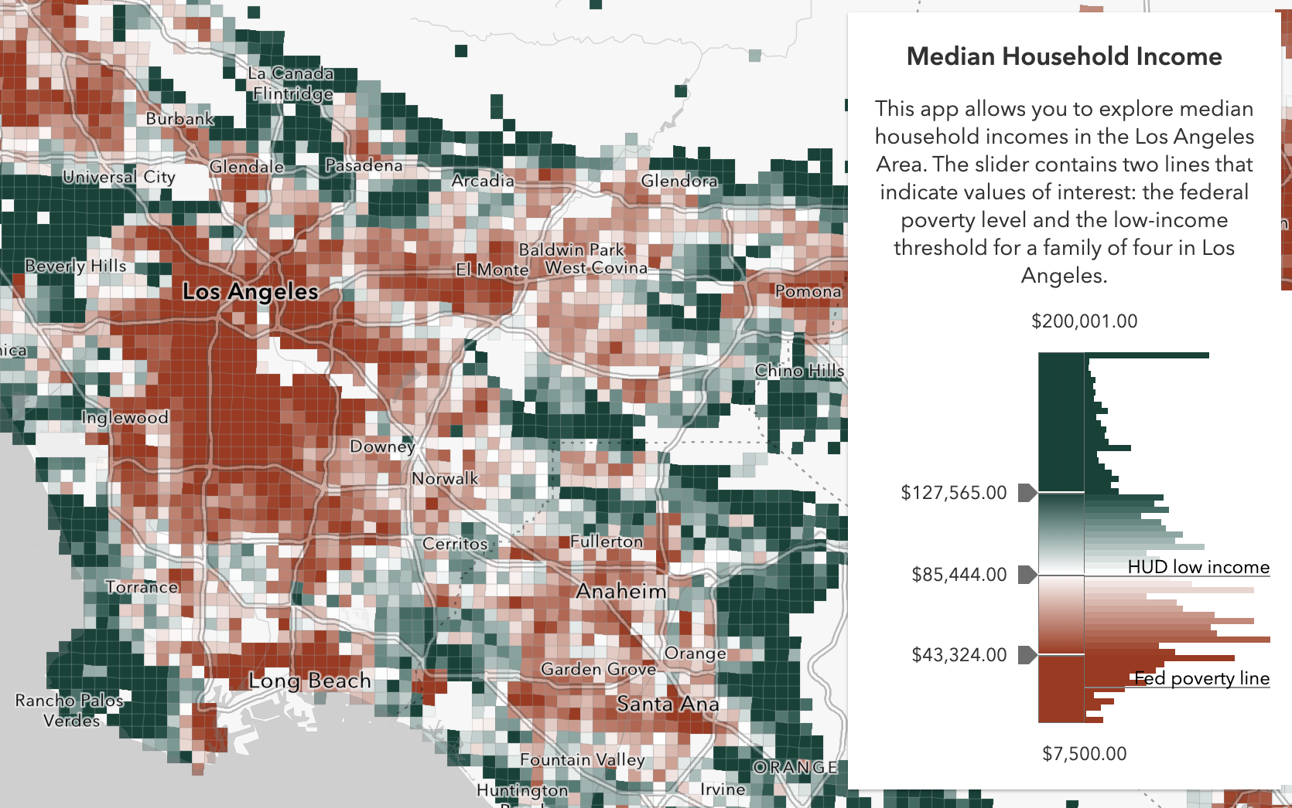
Smart Mapping
It’s all about…
Statistics - Which breaks/stop points make sense?
Color – What colors work best with my basemap? Should it be above and below or high to low?
Class breaks are hard

Slide 24
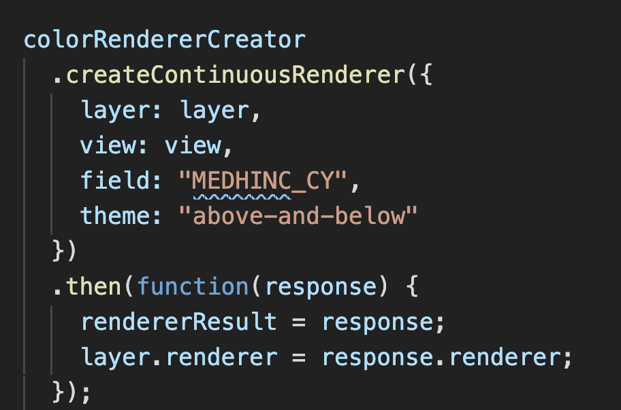
Smart Mapping

Slide 26
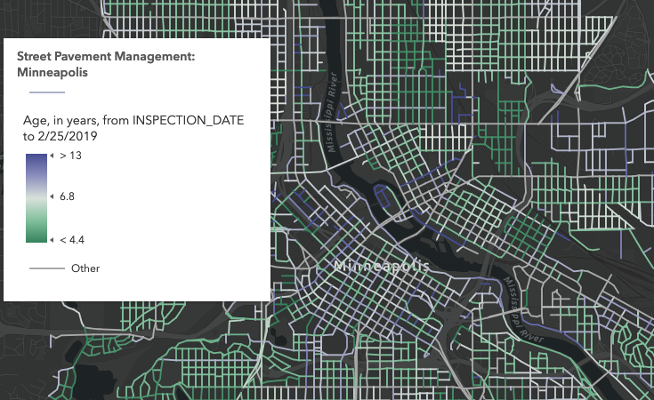
Age

Slide 27
Predominance

Slide 28
Relationship

Slide 29
Symbol Size by Scale
ArcGIS blog: How and why to size symbols by scale in web maps

Slide 30
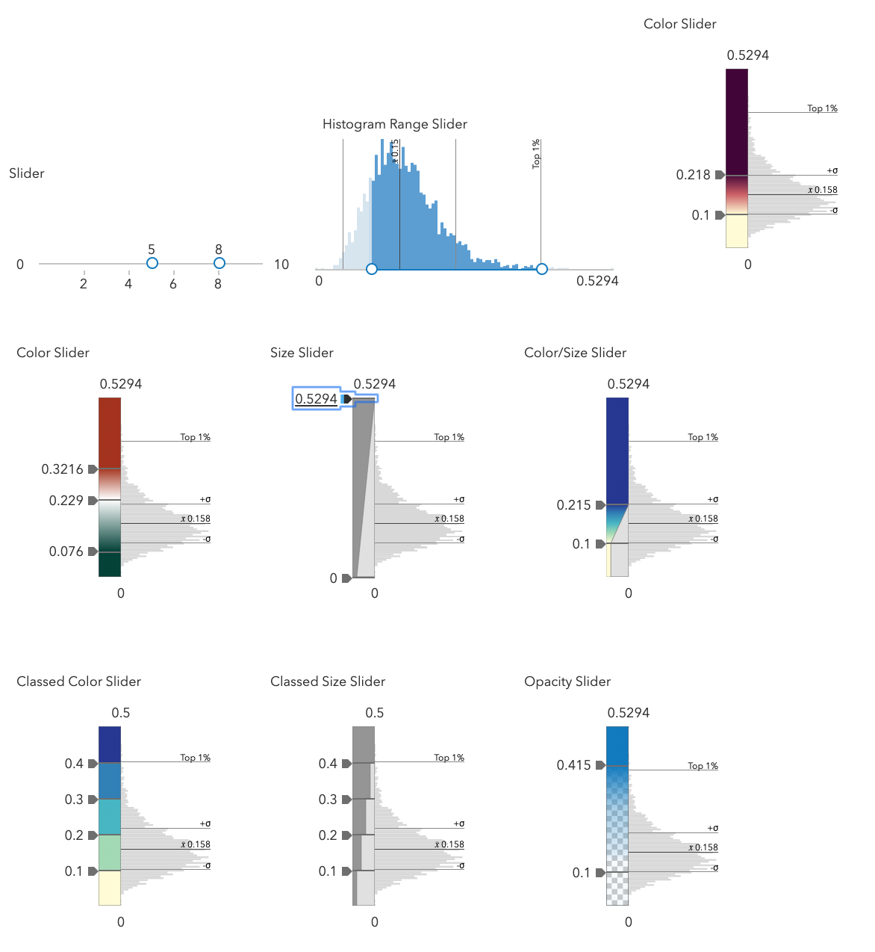
Smart Mapping Sliders

Slide 31
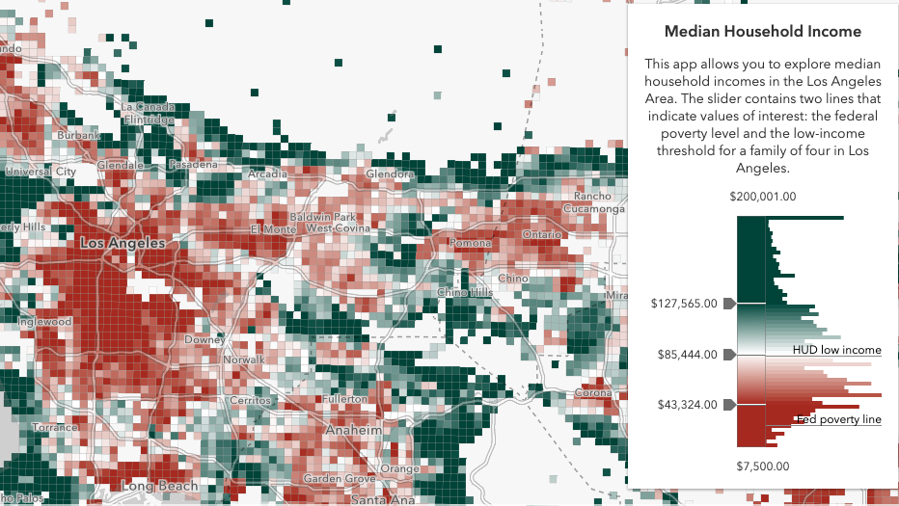
Data Exploration
Smart Mapping

Slide 32
Should I always use Smart Mapping? No!
When to use the Smart Mapping APIs
Data exploration
Renderer authoring
Represent unknown statistical data that updates frequently
Statistic queries
When not to use the Smart Mapping APIs
You know your data well
You use standardized colors or determined by organization
You can author your style in ArcGIS Online or ArcGIS Enterprise portal
Just because

Slide 33
OK. I shouldn’t use the Smart Mapping APIs... but I still need help with my cartography. What should I do?
You can author your style in ArcGIS Online or ArcGIS Enterprise portal and take advantage of everything Smart Mapping has to offer.
Read the Data Visualization guide pages!
Esri color ramps
Data visualization best practices

Slide 34
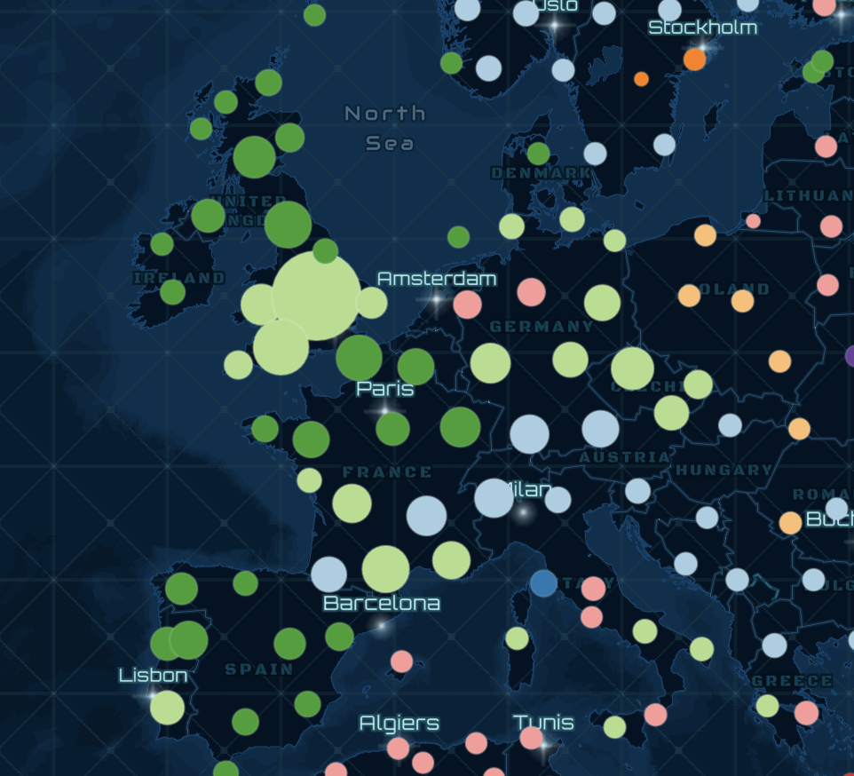
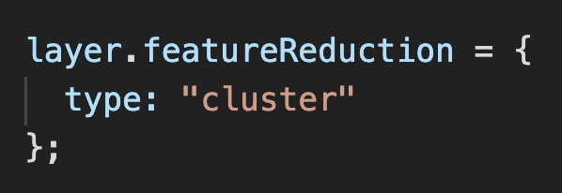
Clustering
FeatureReductionCluster

Slide 35
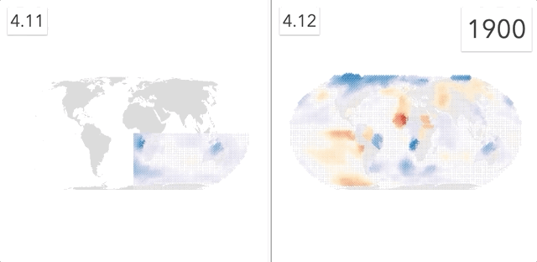
Faster visual updates
WebGL rendering

Slide 36
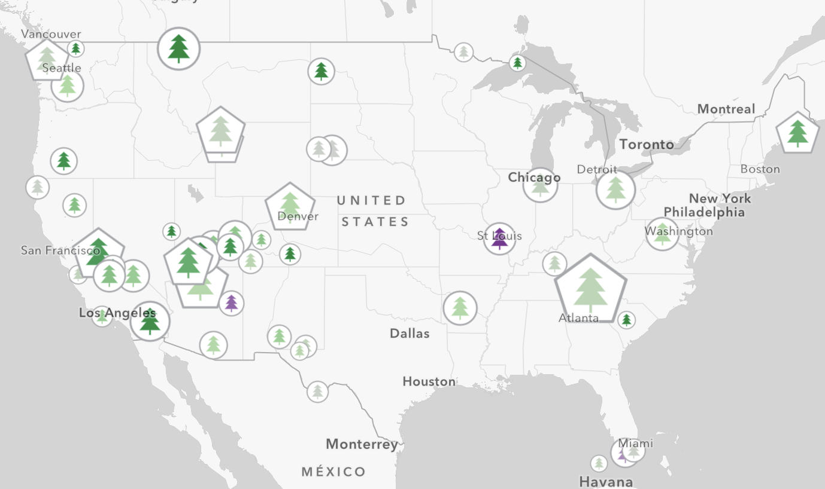
Web Styles, CIM, client-side processing

Slide 37
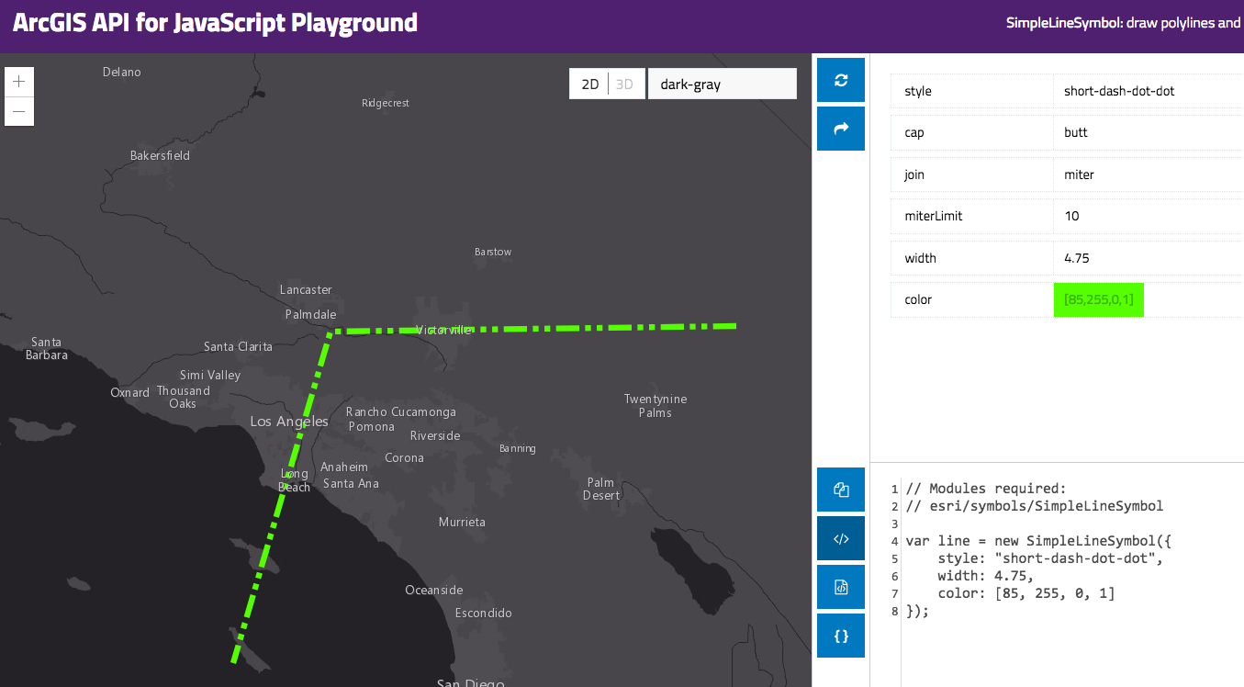
Resources
Get started with visualization
ArcGIS Blog
Visualization Samples
Documentation
Renderer
Symbol

Slide 38


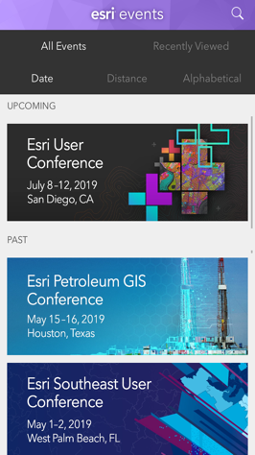
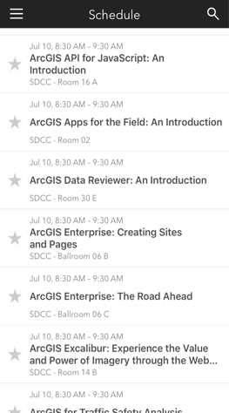

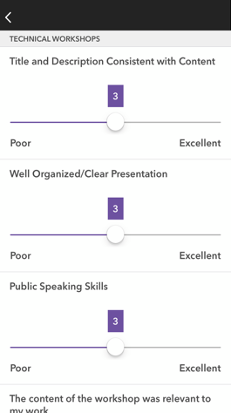




Please Share Your Feedback in the App
Download the Esri Events app and find your event
Select the session you attended
Scroll down to “Survey”
Log in to access the survey
Complete the survey and select “Submit”
Notes:
Guidance:
This is the survey slide. You can use the example as is or you can screenshot your session.

Slide 39


